Slide 1

AI-Based Puzzle Solver Using Backtracking and Heuristics
CSA 0612- Design and Analysis of Algorithms for Backtracking
GUIDED BY:
Dr. S. Tamilselvan,
Dr. P. Solainayagi
SIMATS ENGINEERING
CHENNAI
PRESENTED BY:
P. Dada Kalander (192424272)
K. V. Sai Shanmukh (192424306)
Department of AI&DS
SIMATS ENGINEERING
CHENNAI

Slide 2



Agenda
Introduction
Problem statement
Objectives
Proposed methodology
Architecture diagram
Modules
Implementation
Conclusion
Future scope
References

Slide 3

Introduction
Puzzle solving is a key problem in Artificial Intelligence and can be modeled as a Constraint Satisfaction Problem (CSP).
Traditional backtracking is correct but inefficient for complex puzzles.
This project combines backtracking with heuristics (MRV, LCV, Forward Checking) to improve efficiency.
Real-time visualization and analysis demonstrate the effectiveness of the proposed approach.

Slide 4

Problem statement
Traditional puzzle solvers use basic backtracking, leading to high time complexity.
There is a need for an efficient and intelligent puzzle-solving approach.
Existing puzzle solvers rely on brute-force or basic backtracking methods.
These approaches result in excessive backtracking and slow performance.
An optimized and explainable AI-based solution is required.

Slide 5



Objectives
To design a generic CSP-based puzzle-solving system.
To implement a core backtracking algorithm for correctness.
To integrate heuristics (MRV, LCV, Forward Checking) for optimization.
To reduce execution time and search space.
To provide real-time visualization and performance analysis.

Slide 6
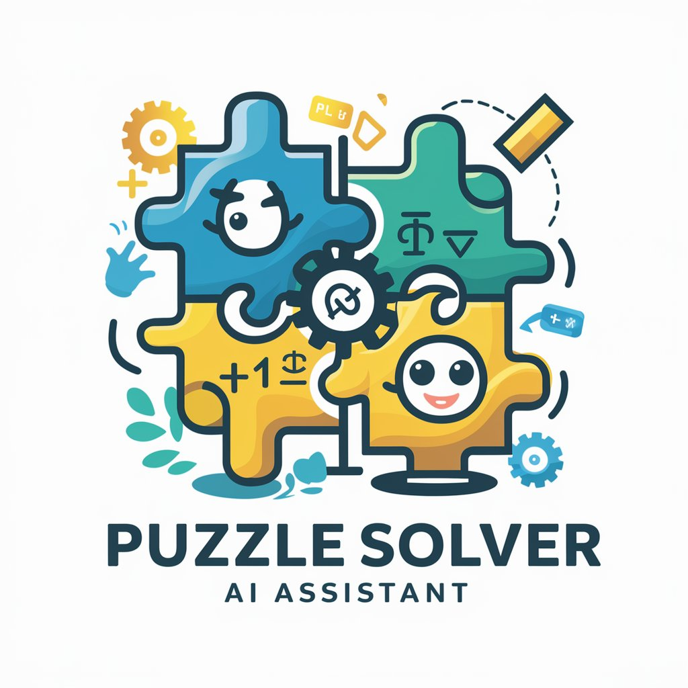
Proposed Methodology
To design a generic CSP-based puzzle solver.
To implement backtracking for correct solutions.
To apply MRV, LCV, and Forward Checking heuristics.
To reduce search space and execution time.
To provide real-time visualization and performance analysis.

Slide 7
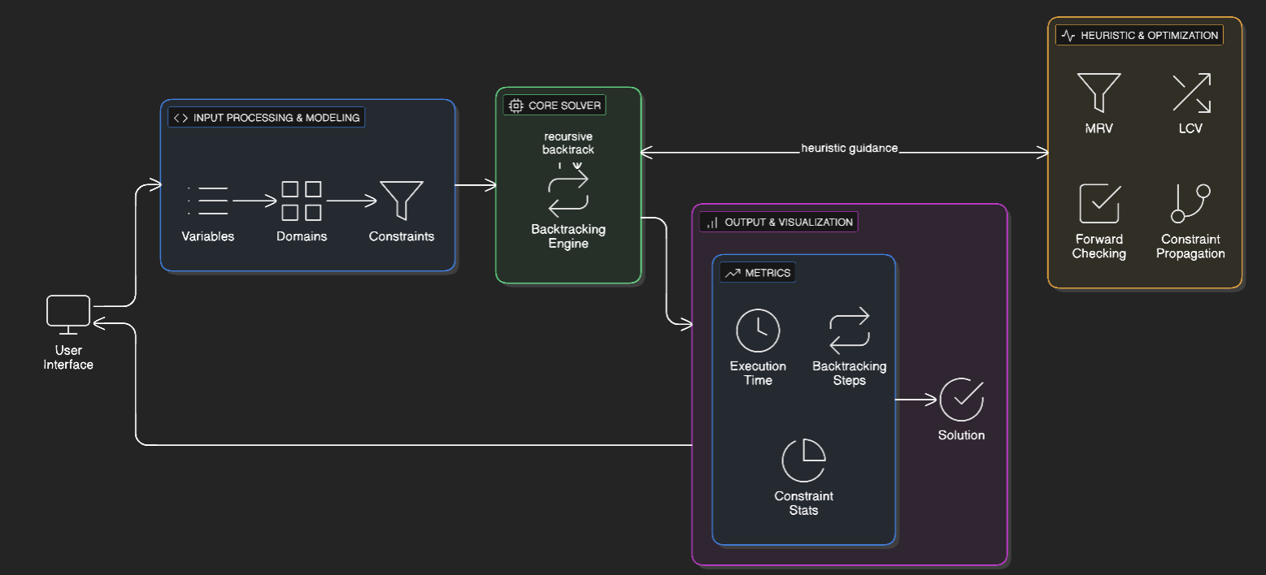
Architecture diagram

Slide 8
Modules overview
Modules:
1. Core CSP & Backtracking
2. Heuristic & Optimization Layer

Slide 9


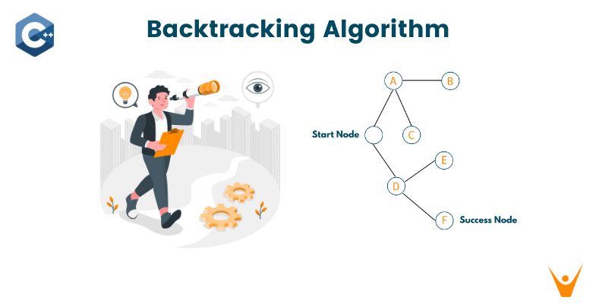
Module 1: Core CSP & Backtracking
Models the puzzle as a CSP (variables, domains, constraints).
Uses recursive backtracking for value assignment.
Checks constraints to detect conflicts early.
Backtracks by undoing invalid assignments.
Works as a generic solver for different puzzles.
Ensures correct and complete solutions.

Slide 10
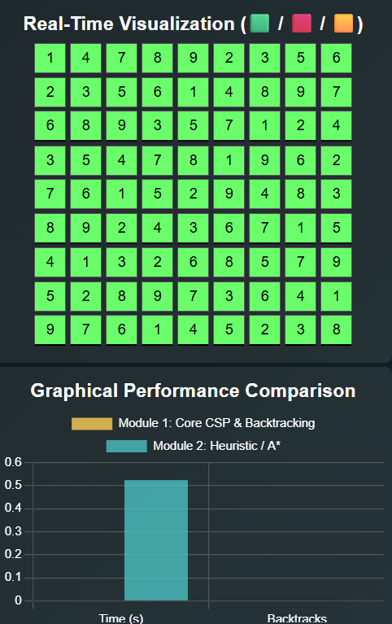
Module 2: Heuristic & Optimization Layer
Uses MRV to select the most constrained variable.
Applies LCV to choose the least restrictive value.
Implements Forward Checking to remove invalid values early.
Performs domain pruning to reduce search space.
Improves backtracking efficiency without affecting correctness.
Reduces execution time and backtracking depth.

Slide 11
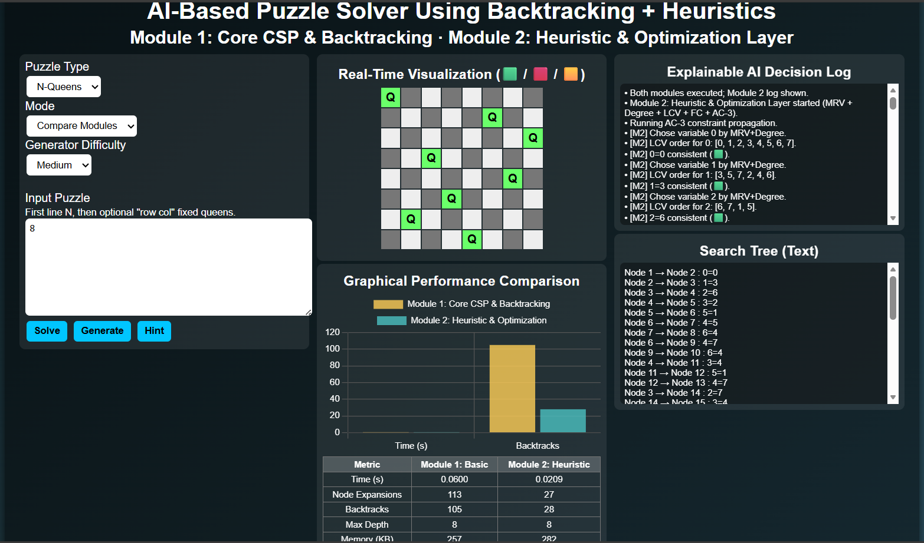
Implementation

Slide 12

Conclusion
Pure backtracking guarantees correct solutions but is slow for complex puzzles.
Heuristic techniques reduce unnecessary search and computation time.
Combining backtracking with heuristics improves overall efficiency.
Applicable to puzzles like Sudoku and N-Queens.
Useful as an educational tool for learning AI search techniques.

Slide 13

Future scope
Extend the solver to support more complex puzzles like crosswords and mazes.
Integrate machine learning to automatically select optimal heuristics.
Improve performance for large-scale and real-time applications.
Develop a visual interface for better understanding and learning.
Enable adaptive heuristics based on puzzle difficulty.
Optimize the system for parallel and distributed computing environments.

Slide 14
References
R. Dechter, “Constraint Satisfaction Problems: Algorithms and Applications,” Artificial Intelligence, vol. 310, pp. 1–25, 2024.
L. Zhang and H. Liu, “Heuristic-Guided Backtracking for Efficient N-Queens Problem Solving,” Journal of Artificial Intelligence Research, vol. 78, pp. 145–160, 2024.
S. Kumar and R. Mehta, “Performance Analysis of Backtracking with Heuristics for Logic-Based Puzzle Solving,” International Journal of Computer Applications, vol. 186, no. 12, pp. 20–26, 2025.
A. Sharma, K. Patel, and M. Verma, “An AI-Based Generic Puzzle Solver Using Heuristic Search Techniques,” IEEE Access, vol. 13, pp. 45560–45570, 2025.
S. Russell and P. Norvig, Artificial Intelligence: A Modern Approach, 4th ed., Pearson Education, 2024.

Slide 15


